Slide 1

Marathwada Mitra Mandal's
COLLEGE OF ENGINEERING, Karve Nagar, Pune - 52
An Autonomous Institute Affiliated to SPPU
Website: www.mmcoe.edu.in email id: mmcoe@mmcoe.edu.in
Department of Information Technology
Community Engagement Project : Review 0 (AY 2025-26)
“EduBridge”
Presented By: SI154 Gaurav Jadhav
SI167 Shreyash Mandlapure
Name of Guide: Mrs S.P. Vanjari
13/08/25
Date:

Slide 2
A Low-Bandwidth Online Proctoring System
ProctorLite
Context of the Project This project's goal is to ensure fair, accessible assessments through a secure, low-bandwidth proctoring system. Area of Focus Our focus is on students in low-connectivity rural regions, where traditional proctoring methods are often not viable.

Slide 3
Introduction
Many students in rural and remote areas lack access to reliable high-speed internet.
Traditional online exam proctoring tools rely heavily on live video streaming, which is bandwidth-intensive.
This leads to unfair assessment conditions, frequent disconnections, and digital exclusion of underserved students.
There is a critical need for a secure, low-bandwidth proctoring solution that ensures fair and accessible online exams for all.
Students in low-connectivity rural regions, especially in:
Government and low-cost private schools
Remote colleges and distance learning programs
Geographically isolated areas (e.g., hilly, tribal, or interior zones)
These students often rely on unstable mobile data or face frequent network disruptions.

Slide 4
Problem Identification
Problem Statement :
Students in rural areas often lack access to high-speed internet, making existing online exam proctoring solutions ineffective. There is a need for a low-bandwidth, secure proctoring system that ensures fair online assessments without relying on continuous video streaming.
Why is this problem important?
Digital education is expanding, but rural students are being left behind due to poor internet infrastructure.
Unfair assessment practices impact the academic integrity and career prospects of students from low-connectivity regions.
There is an urgent need to make online learning inclusive and accessible, especially where education is a pathway to social mobility.
Fair exam systems are crucial to maintaining trust in digital education platforms and certifications.

Slide 5
Problem Identification
Impact on the local community
Empowers rural students by ensuring equal access to online assessments and opportunities.
Enhances access to quality education in low-resource or remote settings.
Builds trust among teachers, institutions, and parents in the fairness of online evaluations.
Encourages greater participation in digital learning, helping to bridge the urban-rural education divide.
Lays the foundation for a scalable, replicable model that can be deployed in other underserved areas, nationally and globally.

Slide 6
Proposed Objective
What the team aims to achieve
The team aims to develop a low-bandwidth, secure, and accessible online proctoring system that ensures fair and credible assessments for students in rural and low-connectivity regions.
Key Objectives
Ensure fair online assessments without relying on continuous video streaming
Make digital exams accessible for students with limited internet or basic devices
Build a lightweight and secure system optimized for low-bandwidth environments
Promote inclusivity and equity in digital education across remote regions
Enable institutions to conduct reliable remote exams even in underserved areas

Slide 7
Literature Review
Sr. No. | Paper Title | Publication Details (Journal name & Year) | Merits | Demerits | Gaps/Findings
1. | Security Requirements for Proctoring in Higher Education | R. Luijben, F. van den Broek and G. Alpár, 2024 IEEE Global Engineering Education Conference (EDUCON) | Enables Remote Education, Enhances Academic Integrity | Privacy Concerns, Vulnerability to Cheating | Student Authentication, Work Authenticity, Prevention of Prior Access, Data Protection
2. | Increasing Automatic Proctoring System Performance using Distributed Round-Robin Load Balancer | M. A. Nugroho, M. Abdurohman and B. Erfianto, 2023 IEEE International Conference on Industry 4.0, Artificial Intelligence, and Communications Technology (IAICT) | Enables Remote Education, Enhances Academic Integrity | Privacy Concerns, Vulnerability to Cheating | Student Authentication, Work Authenticity, Prevention of Prior Access
3. | Exam Proctoring Classification Using Eye Gaze Detection | J. Singh, R. Aggarwal, S. Tiwari and V. Joshi, "Exam Proctoring Classification Using Eye Gaze Detection," 2022 3rd International Conference on Smart Electronics and Communication (ICOSEC), Trichy, India, 2022 | Real-time Eye Gaze Detection, High Accuracy in Cheating Detection | Dependency on Environmental Factors (Lighting, Webcam) Limited Scope | 97.5% Accuracy with CNN Model Classification of Gaze Directions

Slide 8
Literature Review
Sr. No. | Paper Title | Publication Details (Journal name & Year) | Merits | Demerits | Gaps/Findings
4. | Smart Artificial Intelligence Based Online Proctoring System | N. Malhotra, R. Suri, P. Verma and R. Kumar, "Smart Artificial Intelligence Based Online Proctoring System," 2022 IEEE Delhi Section Conference (DELCON), New Delhi, India, 2022 | Emotion detection (CNN), Head pose, Phone/Book detection (YOLO), Fully automated | High computation, Camera quality dependent, Privacy issues | Not optimized for low-bandwidth, Needs lightweight AI models
5. | An intelligent system for online exam monitoring | S. Prathish, A. N. S. and K. Bijlani, "An intelligent system for online exam monitoring," 2016 International Conference on Information Science (ICIS), Kochi, India, 2016 | Rule-based multi-modal (video/audio/window), Head pose (yaw>15°), Low-cost | Rule-based only, False positives, Small dataset | Limited scalability, Needs ML/AI integration
6. | Automated Online Exam Proctoring | Y. Atoum, L. Chen, A. X. Liu, S. D. H. Hsu and X. Liu, "Automated Online Exam Proctoring," in IEEE Transactions on Multimedia, vol. 19, no. 7, pp. 1609-1624, July 2017 | Automated system, 6 modules (verification, text, voice, window, gaze, phone), Hybrid algorithm, Public dataset | Needs 2 cameras (wearcam), Complex setup, High bandwidth/storage | Accurate but impractical for rural, Simplify hardware for wider use

Slide 9
Planned Field Visit / Stakeholder Interaction
Places to visit / People to meet
What data will be collected

Slide 10
Expected Outcomes
A functional low-bandwidth online proctoring system designed for rural and low-connectivity areas
Enhanced accessibility of remote exams for students in underserved communities
Improved exam integrity in low-resource settings without relying on continuous video streaming
A user-friendly interface that works on basic smartphones or computers
A scalable model that can be adopted by schools, colleges, and NGOs working in rural education
Increased digital participation and reduced dropout rates among rural students in online learning programs

Slide 11
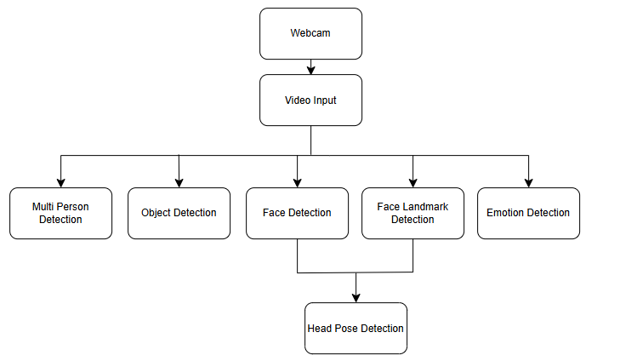
Methodology

Slide 12
Methodology
System Design & Architecture Content:
Frontend: A lightweight interface using HTML, CSS, and JavaScript (vanilla or Alpine.js).
Backend: A scalable backend developed with Flask (Python).
Database: Utilize SQLite for prototyping and upgrade to PostgreSQL for production.
Objective: To create a secure, low-bandwidth, and accessible online proctoring solution suitable for rural and low-connectivity areas.

Slide 13
Methodology
Hardware and Software Integration
Hardware: The system will use basic webcams and microphones.
Computer Vision: Implement periodic image capture using OpenCV with MobileNet or Haar Cascades for face detection.
Audio Analysis: Use PyAudio and Librosa for detecting anomalies in sound.
Background Tasks: Utilize Redis + Celery for scheduling background tasks like image and audio capture.

Slide 14
Methodology
Data Handling & Anomaly Detection:
Data Handling: Enable periodic snapshots and biometric verification with delayed upload support.
Security: Ensure secure data storage using encryption.
AI/ML Integration: Apply lightweight AI models for anomaly detection based on minimal visual and audio data.
Optimization: The models are optimized for low-latency performance.

Slide 15
Methodology
Deployment & Testing:
Deployment: Deploy on low-cost VPS or local college servers.
Compatibility: Ensure cross-device compatibility for basic smartphones and computers.
Pilot Testing: Conduct pilot testing in rural institutions.
Validation: Collect feedback to refine UI/UX and validate fairness, reliability, and accessibility metrics.

Slide 16
Thank You

